Slide 1

FEBRUARY
FEBRUARY
STEPUPS & CONSISTENCY
STEPUPS & CONSISTENCY

Slide 2



NEW DISTRIBUTORS
NEW DISTRIBUTORS

Slide 3



NEW DISTRIBUTORS
NEW DISTRIBUTORS

Slide 4

NEW DISTRIBUTORS
NEW DISTRIBUTORS

Slide 5
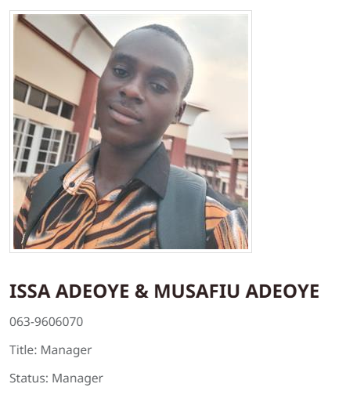

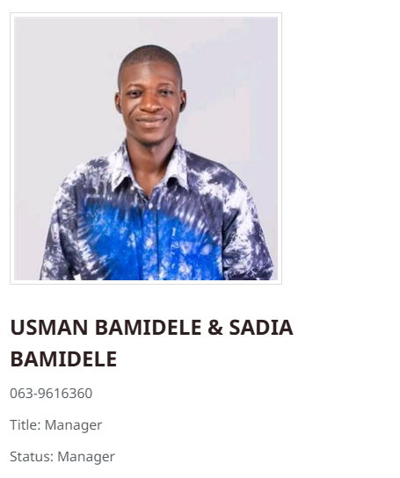
NEW MANAGERS
NEW MANAGERS

Slide 6


NEW SENIOR MANAGERS
NEW SENIOR MANAGERS

Slide 7
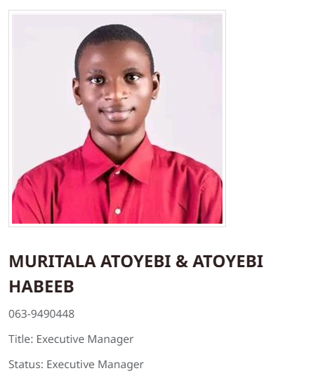
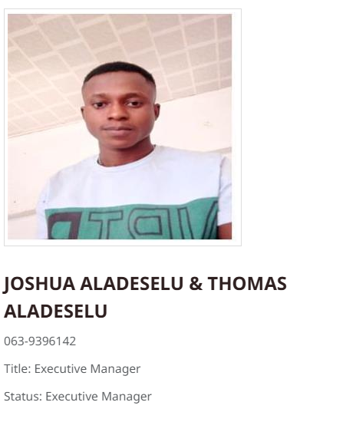
NEW EXECUTIVE MANAGERS
NEW EXECUTIVE MANAGERS

Slide 8
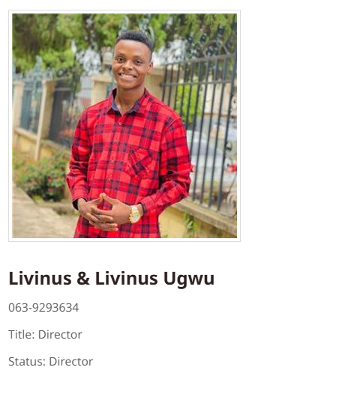
NEW DIRECTORS
NEW DIRECTORS

Slide 9
CONGRATULATIONS
CONGRATULATIONS
TO ALL OUR ACHIEVERS
TO ALL OUR ACHIEVERS

